Slide 1
Monitoring and Analyzing London's Air Quality with Pentaho
Mark Semenenko – Sales Engineer

Slide 2
Agenda
Developing Pentaho Demo showcasing the platform’s end-to-end capabilities
Problem Statement
Use Case Overview
Workshop Content
Demonstration Extension

Slide 3
Pentaho provides flexible management for end-to-end data flows…
Data Engineering
Data Prep
Analytics
Ingestion
Processing
Blending
Data Delivery
Data Discovery / Analysis
Analysis & Dashboards
Administration
Security
Lifecycle Management
Data Provenance
Dynamic Data Pipeline
Monitoring
Automation
Notes:
The Pentaho platform provides a single consistent experience across data engineering, data preparation and analytics.
Along with visualization and analytics at every step in the pipeline
Along with centralized management activities across the pipeline as shown in the bottom boxes.

Slide 4
Problem Statement

Slide 5
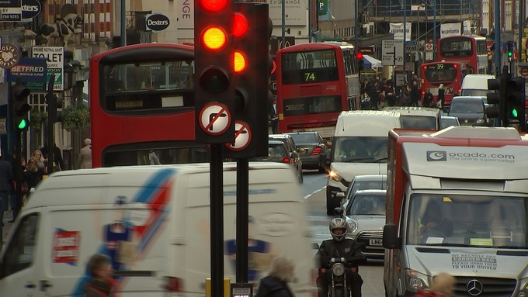

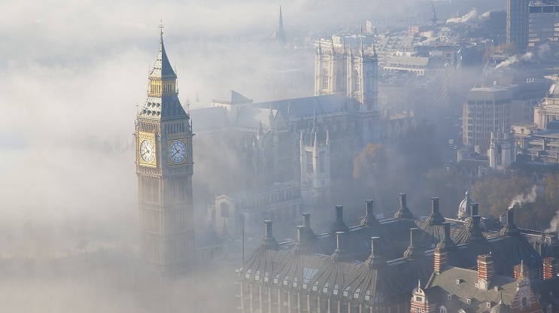

Our Use Case for demo is
“London Air Quality Monitoring”

Slide 6
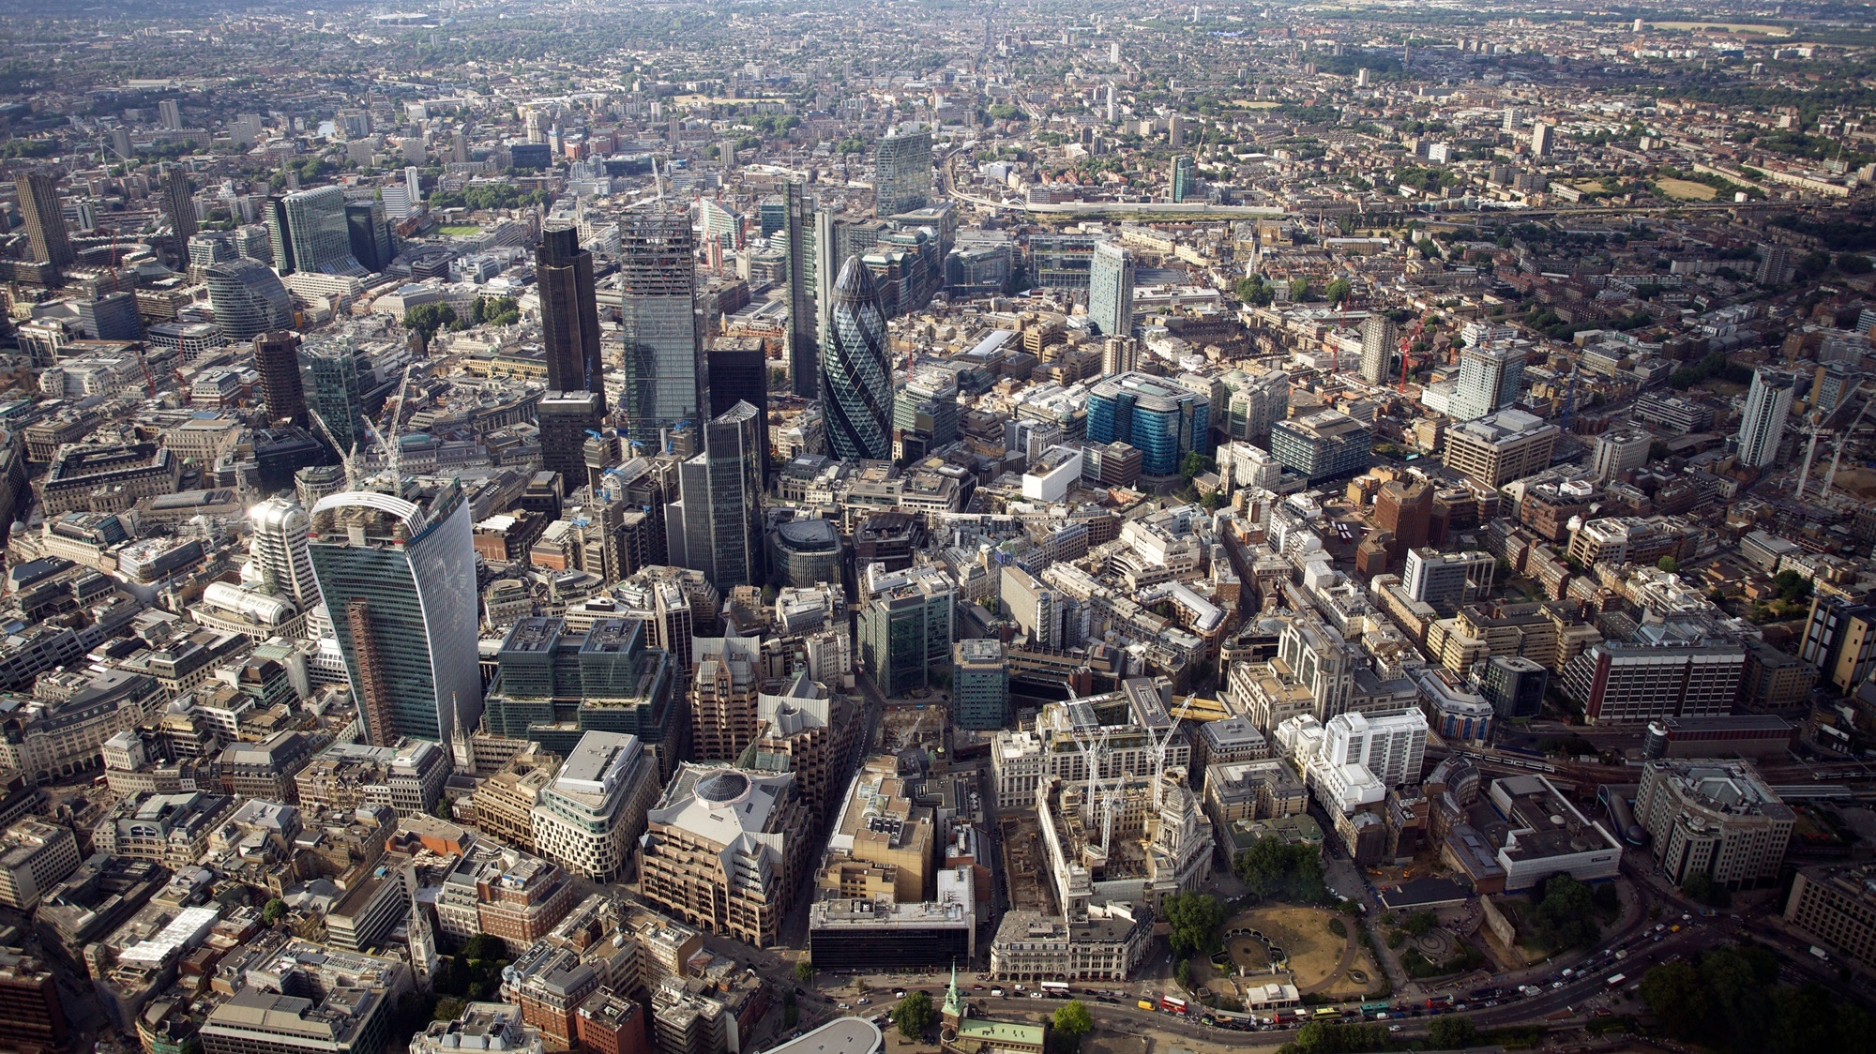
Pentaho
Notes:
Iconic London Skyline and Pentaho office
In this presentation we will be talking about beautiful London city and beautiful end-to-end Pentaho platform

Slide 7
Why?
Air quality affects well-being of residents and visitors of the city
9000 early deaths a year in London due to air pollution
Air pollution monitoring and mitigation are crucial for city councils
The use case is easy to understand and to follow

Slide 8
Use Case Overview

Slide 9



Data Sources
London Air Quality Network (96 stations across the city)
Road Traffic Counts (number and vehicle type)
Meteorological Parameters (wind, temperature, humidity)
Notes:
These are the data sources that would be useful to tackling this issue however we will focus on the sensors in this workshop

Slide 10






Collecting, Preparing and Blending

Slide 11
Workshop Content

Slide 12
You Should Have...
Enterprise Edition Pentaho Data Integration (From www.pentaho.com)
Handbook : “Pentaho LAQ Demo Handbook version 1.2.pdf”
Supplementary file : “SiteCodePostCode.csv”

Slide 13
You Will Have...
A transformation that collects data from 96 monitoring stations across London
Blended air quality data with supplementary data (SiteCodePostCode.csv)
A transformation to create time tables for reporting
Analysis and Geospatial reports of air quality across London
An interactive dashboard of air quality across London

Slide 14
Extension Air Quality Prediction

Slide 15
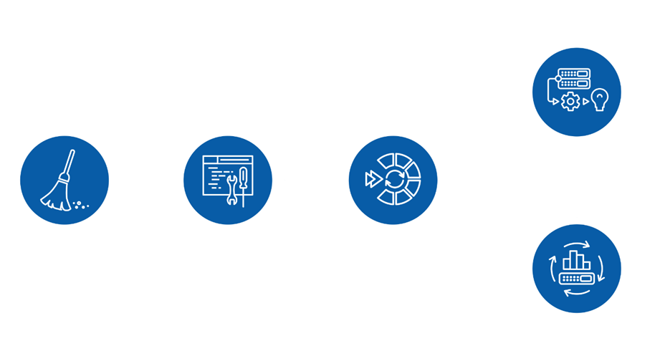
Pentaho Data Science Orchestration
Makes data science teams more productive
Broad support for open source libraries in various languages
Manage model performance, lineage and testing
Notes:
80% of a data scientist time is spent on preparing data and engineering features
PDI can make improve time to get data, train, tune and test and operationalise models

Slide 16
Summary
Pentaho provides a single consistent experience for developing data products
The platform enables easy integration to collection of data from IoT and other sources
Informative dashboards for decision making based on advanced analytics and data transformation in the backend

Slide 17
Good Luck!

